Slide 1

Analyzing user click log data to detect robotic process automation
Andrea Lopez
Mentors: Andrew Galperin, Ping Mamiya
Notes:
Hi everyone, I’m Andrea and I’m a data science intern on the UX research team at Oracle Design. My project this summer is all about using user click log data to detect bots on Fusion. My mentors are Ping and Andrew. Here is my presentation: Are some Fusion users secretly bots?

Slide 2
Research questions
Project Purpose
Are customers automating processes on our enterprise software?
How can we reliably identify robotic process automation (RPA)?
If there is automation, what is it doing, on which apps, and why?
Further questions
Notes:
My project is a research project guided by research questions. They are: are bots using Fusion software? How can we reliably identify bot behavior and distinguish it from human behavior?
And we also want to find out, if there are bots, what are they doing, on which apps, and why?
Shorten this: So before I get into this I want to give you some context about bots. Bots have a negative connotation as people usually think they are used to hack into software systems and steal people’s data, and while that’s definitely true about some bots, not all bots are actually malicious. A bot could be a user who coded something to automate some task so that a human wouldn’t have to do it. A bot can be pretty much any kind of automated online process and actually, bots make up ALMOST 1/2 of all internet traffic.

Slide 3
Clarity of Purpose! Why do we care?
Design:
Understanding why customers automate processes may help us discover automation opportunities.
RPAs may interfere with user experience research by skewing the trends we see in data.
Sales:
If many users are using enterprise software under one account, there is opportunity to optimize our revenue. This information can be used to drive more sales.
Security:
RPAs may be used for malicious purposes.
Notes:
So with that let’s get into clarity of purpose. My project has implications and uses for lots of departments at Oracle. For Design, detecting bot behavior is relevant because it provides insight about our users. If we think users are automating one or more specific tasks, frequently, in specific apps, that may be an opportunity to redesign that interface or create some automation software ourselves to make things easier for our users. Another thing is that when we do quantitative user research, bots may be skewing our results and we may not get an accurate picture of what human users experience when they use Fusion. So being able to pinpoint bot behavior would be useful.
For sales, I wrote here about many users using one account. This is because as I was doing this project I was looking at rapid clicking or many tasks being completed at the same time by supposedly one human. This could be bot behavior or sometimes it might be many people using one account. If that’s happening then that means that customer should be paying more and may be willing to pay more, so this can drive more sales.
And lastly being able to detect bots in user data is useful for security because as I mentioned, some bots are malicious and pose security threats.
ANDREW – FEEDBACK NOTES:
Keep the slide text as is – Vasudha, Lila, Angel, Manas all loved this is “great context-setting” ☺
While discussing Point 2, say explicitly that 2+ users aren’t supposed to be sharing the same user ID – that’s now how Oracle sells our products.
Emphasize even more that 2/3 of internet traffic is bots – that’s crazy interesting! (Carolyn)

Slide 4
Getting to know the dataset
1 week timespan
2.7M user sessions
736 customers
103M user actions
915K users
Customers
Users
Sessions
Windows
Actions
Notes:
So next let me tell you about the data I’m working with. In my dataset, each row is one click with lots of features about it, including the time of the click, the app, which user and customer it was, and a lot more.
The data spans 1 week in September 2020. I’m using 2020 data because more recent data is collected in a more aggregated way that doesn’t suit the purposes of my project as well.
In the data there are 763 customers, which have 914,613 users.
The number of user sessions is 2 million 600 thousand, where a user session is basically one user sitting down, clicking for a while without any long breaks, and then stopping.
In total there are over 103 million user actions, or clicks, and each of these is 1 row in the dataset.
Explain diagram top down
ANDREW – FEEDBACK NOTES:
A session is one user ID using our software continuously in one sitting. It should be one user, but maybe it’s not!
The reason we’re using older data: starting in 2021, we stopped getting raw ADF data. All we have now is slightly aggregated data in 5-minute increments, which means we can’t tell the order of the clicks within each 5-minute block. And knowing the order is crucial to distinguishing bots from humans. Still, as a side note, the new 2023 aggregated data validates our suspicion that there are bots: unlike the old raw data, it has non-hashed user IDs, some of which are called “RPA”, or “Robotic Process Automation”. So we KNOW new data has some bots; and we suspect the older data has some as well. And it’s in the older data where we can actually tell what bots might be doing. (Andrew)
Plz fix the super-bright “of”s that stand out. Maybe color-code the relevant high outlier numbers in Redwood-red or Redwood-orange (all other numbers stay green) (Carolyn)
Separate this into two slides (or two columns like you had early on): the “boring” pure descriptor stats (the first 5), and the actual “shape of data” stats (the last 3) (Carolyn)
Indicate what proportion of sessions are outliers on your 3 measures of bot-like behavior (Lila)
Somewhere, show off your Python skills by pasting a screenshot of some cool code (maybe in the same slide that also shows a snippet of raw data) (Lila)
More visuals instead of stats/text would be great (Shirsha + Carolyn + others)
SHARE PERCENTAGE OF OUTLIERS

Slide 5
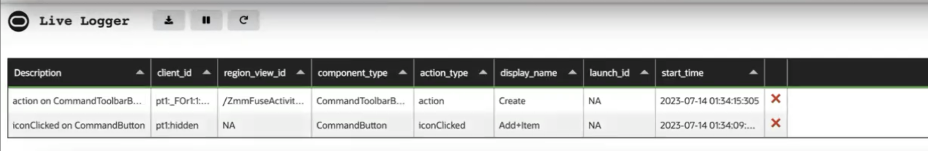
What happens when a user clicks on the software?
Notes:
To give you a better understanding of my dataset, here’s basically what the data collection looks like. At the top I have a user interacting with the UI, and at the bottom I have a click log. A user clicks something and then a new row shows up in the data which shows the time they clicked, what UI element was clicked, who clicked it, etc.

Slide 6
My Methodology
Clean & preprocess the dataset
Examine the entire dataset.
Examine the shape of various features.
Look for outliers.
Identify potential indicators of RPAs.
Choose one user session that stands out and examine it more thoroughly.
Generalize my results to other sessions.
Notes:
So next I’ll get into three metrics from the dataset that I investigated further because I thought they might lead me to find bots.
The first is if there is an abnormal amount of browser windows being clicked in a session.
Second is if the session duration is abnormally long.
Last is if the session contains rapid clicking.
So next I’ll show you what I considered “abnormal” and what the data looks like for these metrics.

Slide 7
Step 1: Data Cleaning
Sorting the data
Problem where users and sessions were not distinct across customers, solution was creating a new user-distinct and session-distinct column combining the id with the customer id
Problem with shifting

Slide 8
Step 2: Explore the data, identify potential indicators of RPAs
Three types of “suspicious” behavior
Session has large number of windows
Session is abnormally long
Session has rapid clicking
Notes:
So next I’ll get into three metrics from the dataset that I investigated further because I thought they might lead me to find bots.
The first is if there is an abnormal amount of browser windows being clicked in a session.
Second is if the session duration is abnormally long.
Last is if the session contains rapid clicking.
So next I’ll show you what I considered “abnormal” and what the data looks like for these metrics.

Slide 9
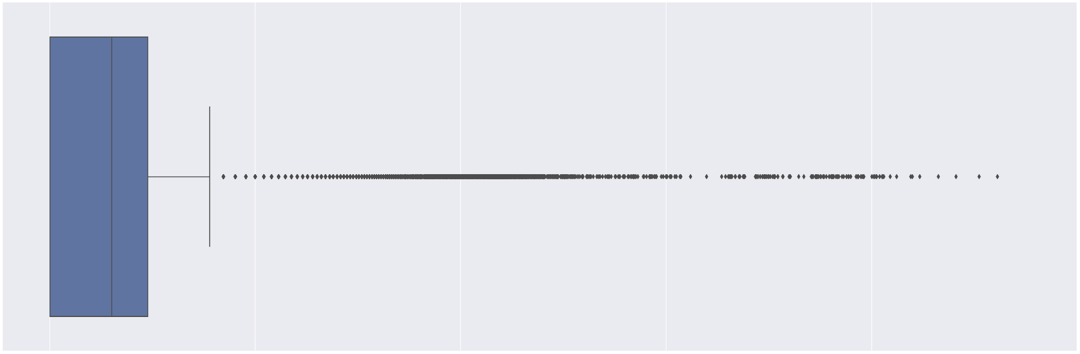
Shape of Data
Number of windows per session
Number of windows (logarithmic scale)
Notes:
So looking at that first metric, number of windows. As you can see in this boxplot, most sessions have 1-3 windows in the session, but we also see some extreme outliers, the maximum being 40,975 windows in one session. I don’t know about you all, but I’ve never had 40,000 different windows open in one session of using my laptop.
10% of sessions are outliers in terms of number of windows.

Slide 10
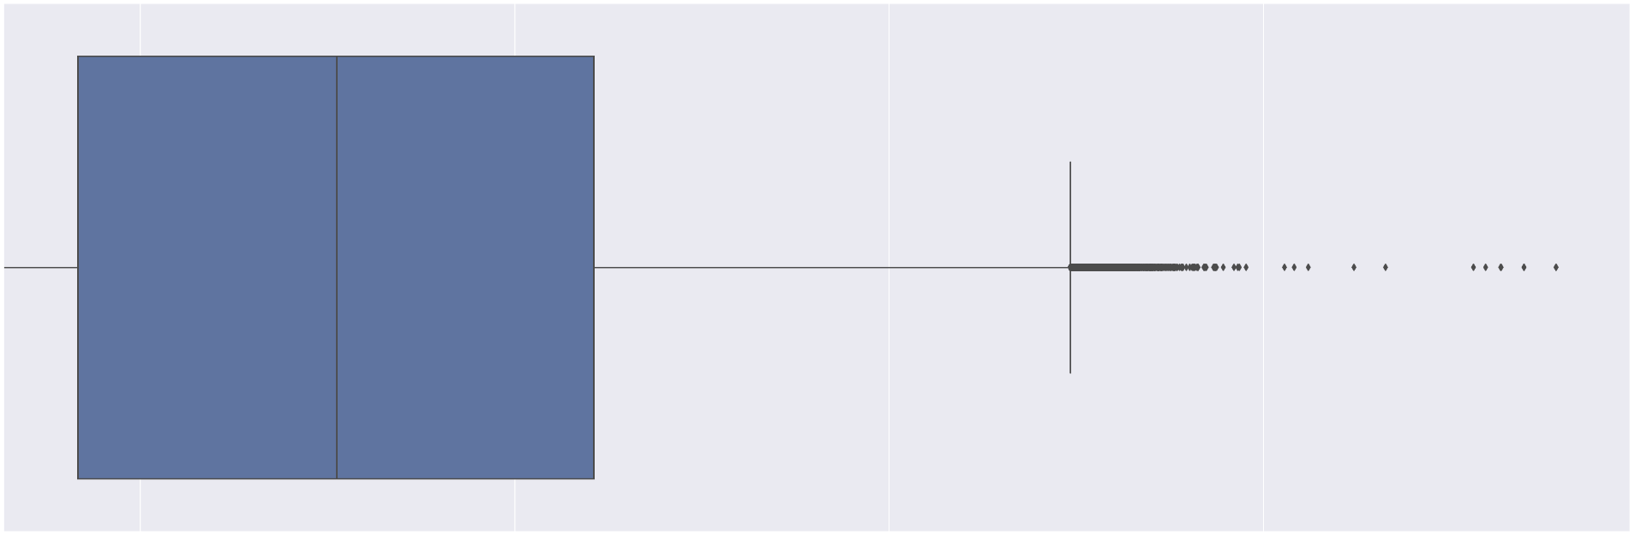
Shape of Data
Duration per session
Duration (logarithmic scale)
Notes:
The next metric is session duration. Most sessions are 1-27 minutes long but some are as short as 0 seconds or as long as 7 days.
0.2% of sessions are longer than 8 hours long, which is a threshold I chose because it’s the length of a typical workday.

Slide 11
Findings
Notes:
So next I’ll go into how I arrived at some findings by looking at these metrics

Slide 12
Even though a very small percentage of sessions are RPAs, these sessions make up a much larger percentage of all clicks
Notes:
So just to give you a rough idea of the scope of the problem, 1.58% of sessions were outliers by any of the 3 metrics I mentioned earlier and I think this is roughly the amount of sessions that may be bots. This may seam like a small number but because they’re so long with so much rapid clicking, they actually make up 18% of the clicks in the entire dataset. Just to clarify I haven’t confirmed this but just wanted to give a very rough estimate.

Slide 13
Step 3: Investigating one session
One suspicious session
Tens of thousands of different browser windows
Abnormally long duration
Rapid clicking
Notes:
So just as a reminder, these are the three metrics: number of windows, duration, and rapid clicks.
I picked one session to investigate that was an extreme outlier. It has 40,975 windows, it’s 11 hours long, and has rapid clicking. So I thoroughly investigated this session in hopes of generalizing my results to the rest of the data.

Slide 14
Pattern found in this session
Repetitive click sequences
6 click pattern occurs in 1000+ windows
This pattern of 6 clicks is always in the same order.
These 6 clicks take place in a sales app.
These 6 clicks take place in up to 100+ windows per minute.
Notes:
So I isolated one pattern of 6 clicks that happens in 1,143 windows. In these windows, the pattern is always in the same order. They are in the Sales Analytics app. Let’s take a look at what these look like in the UI.
First the user clicks to open Analytics, then switches from Favorites to Recently Viewed, then switches to List view, then clicks on some item, then clicks Done very shortly after without spending much time there, then exits the app. And I’ll get into what this might mean later.
So after finding these 6 clicks I still wasn’t convinced that it was a bot and not just many humans. If the same 6 clicks were clicked 1,143 times over 11 hours that doesn’t seem too crazy, maybe it was only one at a time. Or maybe it was a few at a time so maybe a few humans could accomplish this at the same time. So I wanted to find out, in how many windows does the pattern occur in the same interval? I found that in intervals of 1 minute, up to 120 windows click these 6 clicks. I still wasn’t convinced. What if it’s just 120 humans? So I graphed this over time to see what it looked like.
ANDREW – FEEDBACK NOTES:
First & foremost, mention this is in the Sales Analytics app (Andrew)
Why picked the 6-long sequence to analyze? It had a suspicious peak between 5 and 7 – a distribution far different than random chance (Andrew)

Slide 15
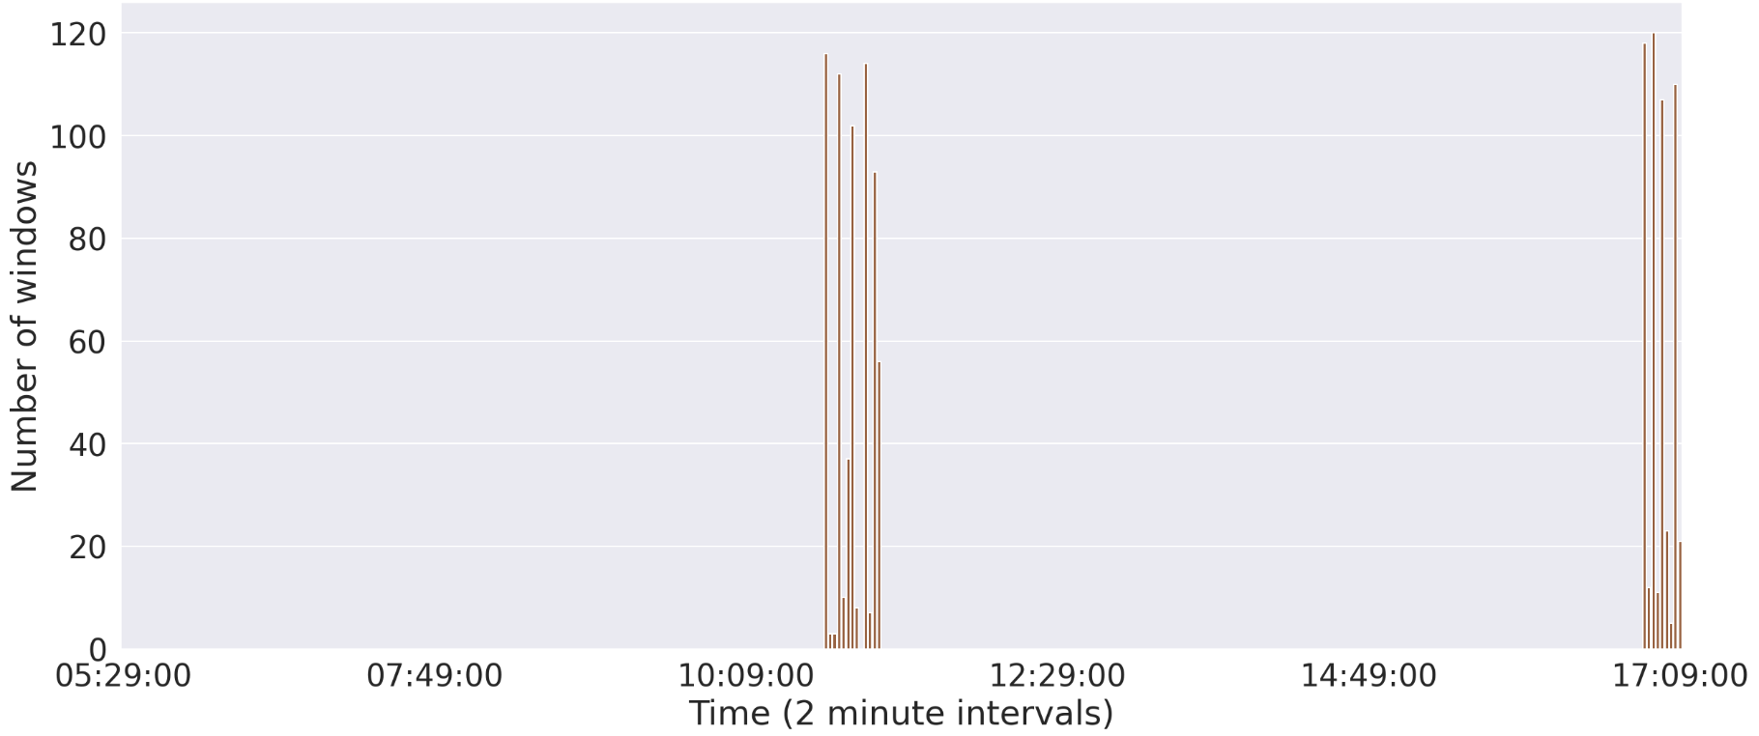
Number of windows which click this pattern over time
Notes:
So here is the pattern graphed over time. The x axis is 2 minute intervals and the y axis is number of windows being clicked. I used the number of windows because I figured that one human could only work in 1, MAYBE 2 windows in a 2 minute interval, but here we see up to 120 windows in a 2 minute interval.
Here you can see that this pattern happens in 2 clusters in the session. For the first few hours this pattern doesn’t happen, then suddenly this pattern is being clicked in up to 120 windows in a single minute. Then nothing again, then another cluster.
So this to me looks very clearly like bot behavior because not only are there many windows repeating the exact same sequence, but they all happen all at once in a small cluster of time. It would be very strange for 120 humans to all decide to click this pattern in just a few minute interval.
So next I said, okay, are there other patterns and what do they look like on this same graph?

Slide 16
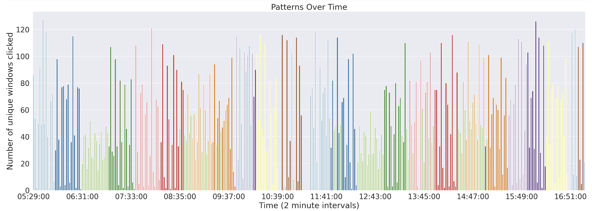
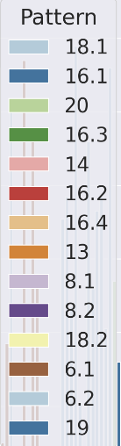
All patterns in this session
Notes:
So next I went ahead and did the same thing for patterns of different lengths, not just 6. Here on the graph are the most prevalent patterns.
And you can see here that not only are the 6s in clusters, but all the patterns are clustered! Basically at the start, they are clicking one specific pattern with length 18 across 100 windows. Then they stop that and switch to another pattern, then stop that and switch to another. And you see they do this entire process twice. You can see it’s green, yellow, pink and blue, coral, yellow, green, pink blue and other blues, red, green, torquise, orange. Then they do this exact thing again.
So let’s say this was many humans. That would mean that at least 100 or 120 or so humans would have had to coordinate clicking the exact same thing in the exact same order at the exact same time frame.
Also every pattern is very similar. They all take place in Sales apps and they basically just go into the app, click a data item, click through all the pages of the item, then click “Done” without editing anything or spending much time on the item. They don’t do anything that would be captured by the data because the data can’t see things like copy and pasting or screenshotting. This might mean that the bot is scraping the data. Data scraping is when a bot gathers data from online onto a spreadsheet or some other location on their local machine. This is a common use of bots so it seems likely that that is what’s happening, but just to clarify, it’s not the only possibility and it would require more research in order to figure out exactly what’s going on.
ANDREW – FEEDBACK NOTES:
What are the total/max windows open in any one time interval? (Vasudha). Too many might actually be evidence against a bot, since one computer can’t possibly have that many windows open at once.
Find a session from a ”very busy” human user that still doesn’t look at a all like this, & show it side by side (Akbar + Carolyn)

Slide 17
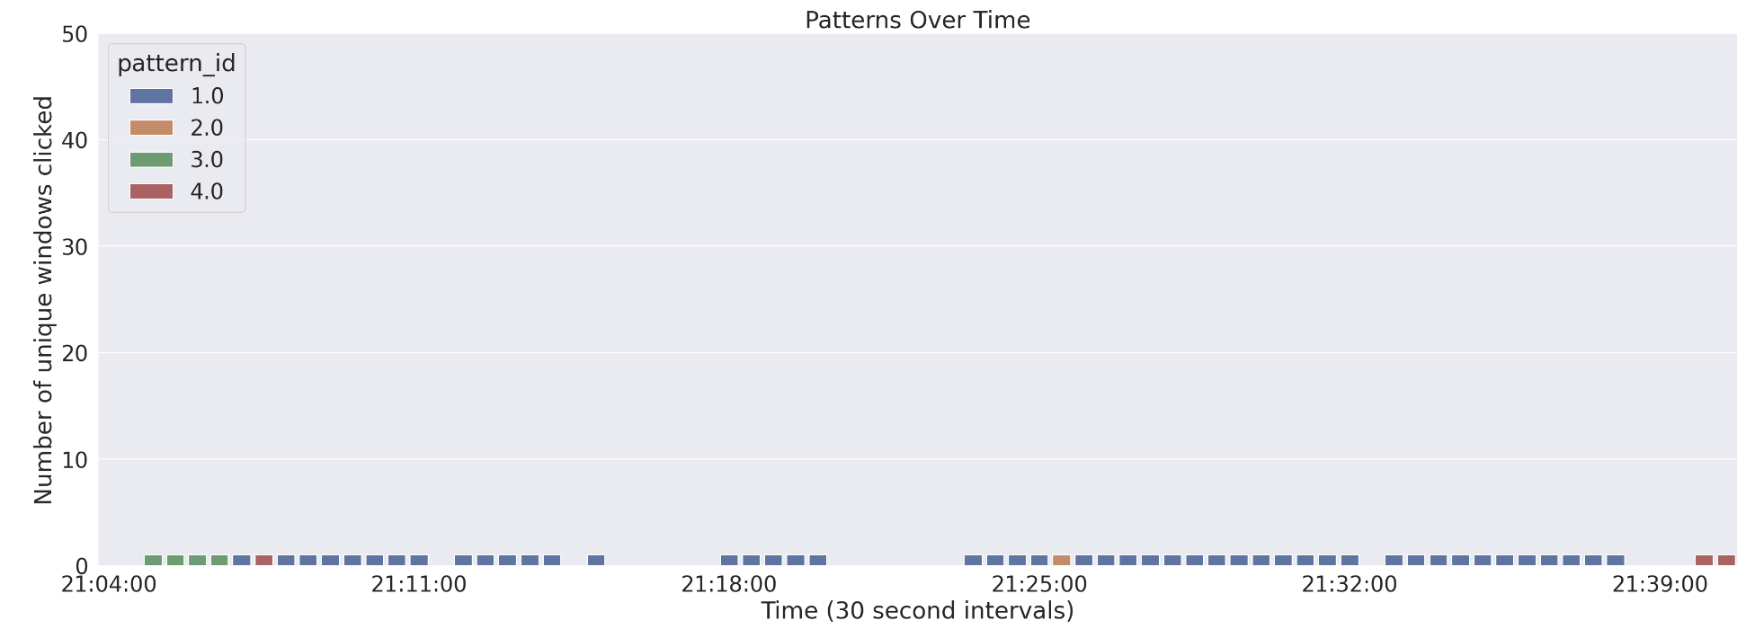
Human User vs. Bot User
Notes:
Here’s what it looks like compared to a human user. A human only works in 1 window for the whole session, you can see that the patterns of clicks are not clustered. The human probably logged in, did some repetitive task for a while with maybe a couple interruptions, then did some sort of logging out sequence. Meanwhile the bot works in many windows at once and does repeated patterns.

Slide 18
Why do I think this is bots?
Why can’t this be 1 human user?
1 human cannot rapidly switch between thousands of windows for many hours straight with no breaks
Why can’t this be many humans?
It is implausible that dozens of humans coordinated clicking the same UI elements at once in such a systematic, clustered way.
Notes:
So again just to reiterate, this can’t be 1 human because 1 human cannot rapidly switch between thousands of windows for 11 hours straight with no breaks, and it can’t be many humans because it’s implausible that at least 100 people coordinated clicking the exact same elements at the same time in such a systematic clustered way.
ANDREW – FEEDBACK NOTES:
If there aren’t any long breaks (say, 5+ minutes), that’s additional evidence it’s a bot (Mike)
This is true for our most-analyzed session; whether it’s true for other sessions probably depends on the thresholds used by your pattern-extraction function

Slide 19
Key takeaways
Some customers may be automating repetitive tasks in enterprise software apps.
They may be using bots to scrape data from enterprise software.
Repetition of frequent patterns in many windows is a potential indicator of bot behavior.
Notes:
So what are my key takeaways from this. Customers may be automating repetitive, tedious tasks in Fusion apps. And in this session at least, the bot may be data scraping, which may suggest that maybe customers aren’t solely using Fusion to store their data, maybe they also keep it somewhere else and maybe they need an easier and quicker way to download all their data to their local machine. Again this is merely speculation, it’s just one of many possibilities, but I just wanted to mention it to give you an idea of how these findings can inform design decisions.
Another takeaway is that repetition of frequent patterns in many windows is a potential indicator of bot behavior, and the Python function that I wrote to find all the patterns and graph them is useful in investigating other sessions for bot behavior!

Slide 20
Next steps
Is RPA behavior similar within or across customers?
Explore other types of RPA behavior
Understand why customers are automating certain tasks.
Notes:
The next steps in the project are to investigate whether bot behavior is similar within or across customers.
Also explore other types of bot behavior, for example I looked at the longest session which was 7 days and it turns out it only has 2 unique clicks, so for 7 days someone is clicking 2 things back and forth over and over, and it’s just basic clicks like clicking your own profile picture. This doesn’t seem as much like data scraping so there’s probably lots of different types of bots to investigate.
And lastly we want to understand why customers are automating these tasks using bots.
ANDREW – FEEDBACK NOTES:
Before this slide, estimate how widespread bots are – or at least the type of bot behavior you’ve closed analyzed. This slide might also contain a bullet like “find other types of bot behavior” (e.g., the 7-day session consisting of only 2 click_codes)
Looking at the spacing of clicks within the same pattern (Akbar). “I started doing this for one pattern in one session and there was something to it, but not absolutely clear” – or something like that which shows you’ve thought about it and started exploring it.

Slide 21


What I learned!
How to explain highly technical concepts to a non-technical audience
How to look ”beyond the numbers” and understand the real human experience or “story” behind the data
Notes:
What I learned
What I learned! So this summer I learned about exploratory data analysis, working with large datasets, UX research, and lots more technical stuff. But more specifically, I learned how to explain highly technical concepts to a non-technical audience. This is a really valuable skill because even the most talented data scientists, if they can’t explain their findings to a stakeholder who may not know very much about data science, their findings won’t have as much impact. I also learned about looking beyond the data, looking past the numbers, to understand the real human experience behind them. I think these are unique and valuable skills that I gained by being a Data Science Intern for Design which is such an interdisciplinary field.

Slide 22
Thank you!
Notes:
That concludes my presentation, thank you!

